Slide 1
The use of ML to predict serious illness by using Random Forest
Group : 4 Sadeem Alfajeh Nora Almutahar Salwa Alowiyd Maram Alolaqi Sarah Zubayen

Slide 2
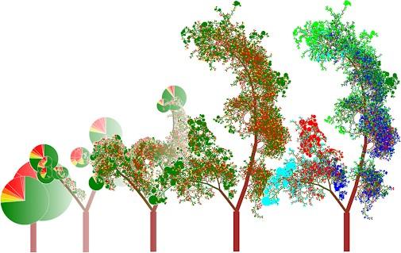
Outline:
Introduction to the use case in Fintech.
Brief explanation for the dataset.
Some technical steps for modelling.
Some description of models performance.

Slide 3
Introduction to the use case and how can be useful for the InsureTech company
The purpose of this project is to predict from dataset if someone will get serious illness like heart attack or stroke in the future from the smoking habit. The use of ML algorithms in this process helps the Insurtech companies to understand the beneficiary and determine the cost.
We think that our work will help Insurtech companies to analyze data and extract important information from it that can lead to better decision making and strategic business development like the process of pricing strategies or policies.

Slide 4
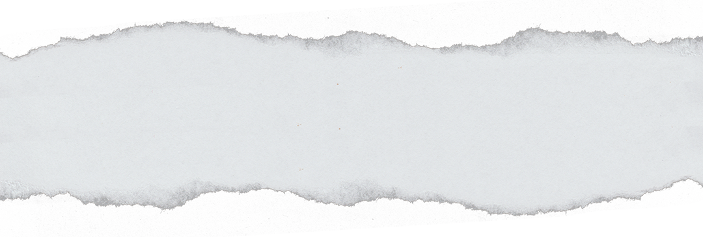

This dataset is from kaggle, it contains 16 columns with features that usually effect heart health. so we are using the 'TenYearCHD' as our labels and the rest of the data set as our features. and then we'll apply Random Forest Model on that base.
https://www.kaggle.com/dileep070/heart-disease-prediction-using-logistic-regression

Slide 5
Random Forest:
Random forest helps us to determine which variable have the most effect or causing on the target

Slide 6
Thank you

